Slide 1
CECILIA WANGARI NGUNJIRI data science PROJECT
Mental Health Prediction

Slide 2
Mental health issues have been a very rampant issue globally affecting most people, both the young and the old. The reason for mental health issues and its increase is due to a number of reasons which include; childhood abuse, trauma, or neglect.
Diagnosing mental health is difficult because people aren’t always willing to talk about their problems.
The analysis below shows how mental health has affected people across different countries with an attempt to create a model that will predict mental health issues.

Slide 3
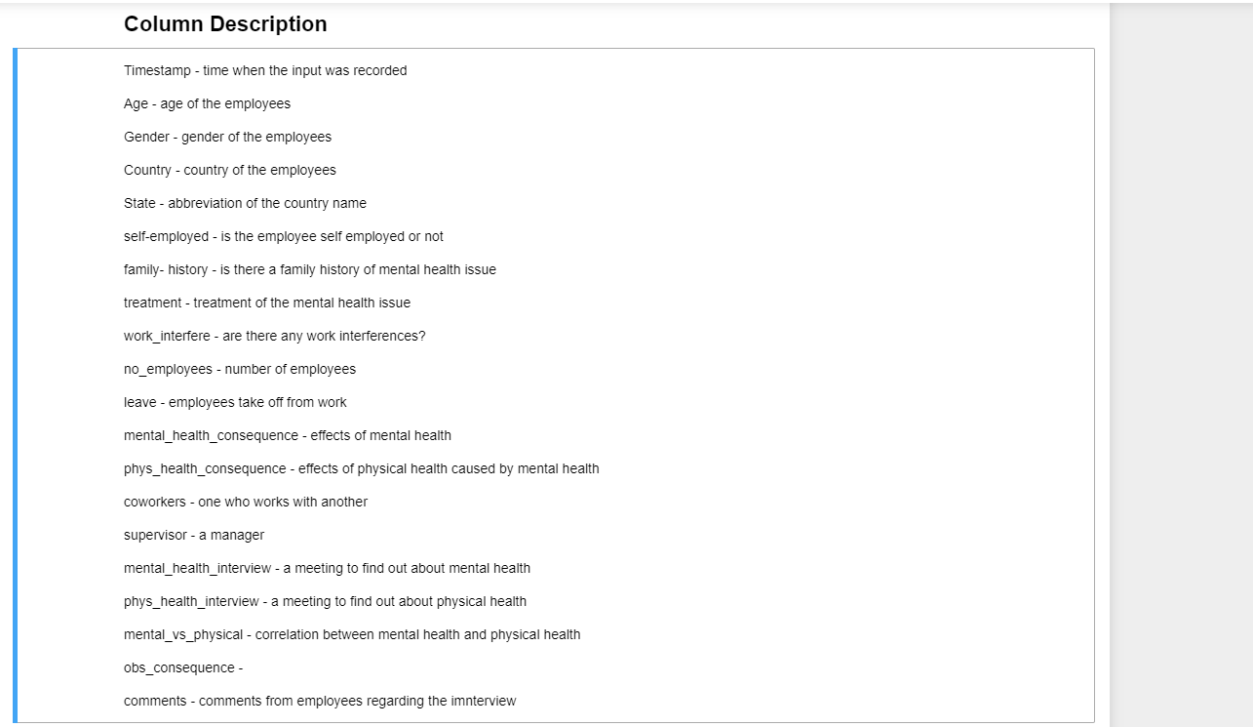

Slide 4
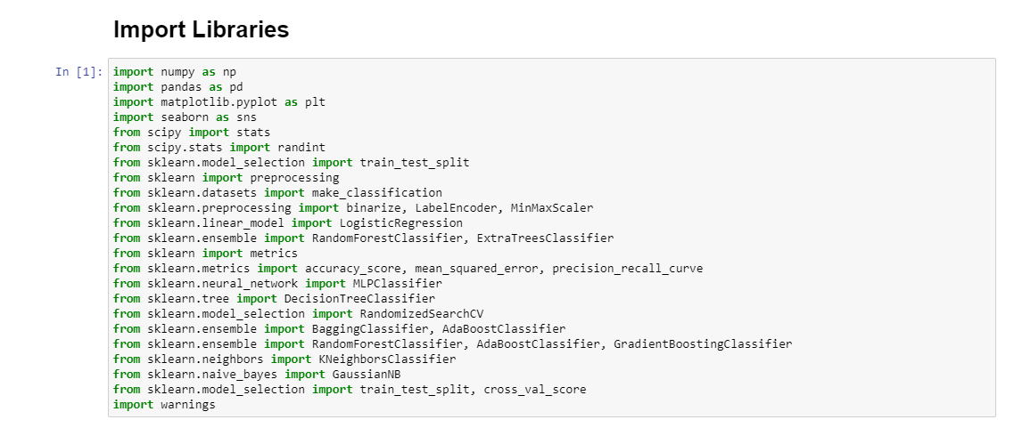

Slide 5
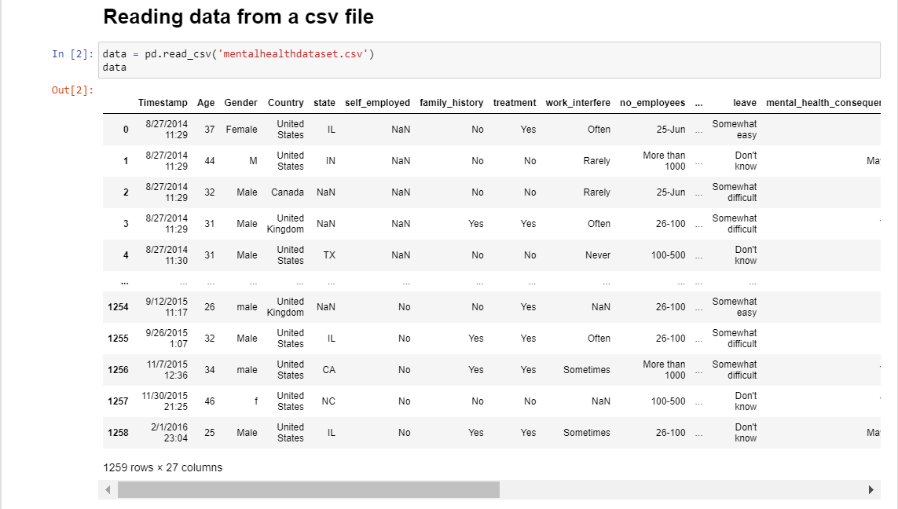

Slide 6
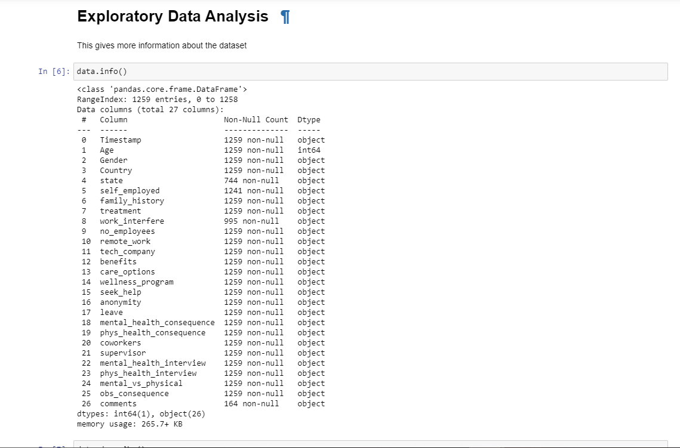

Slide 7
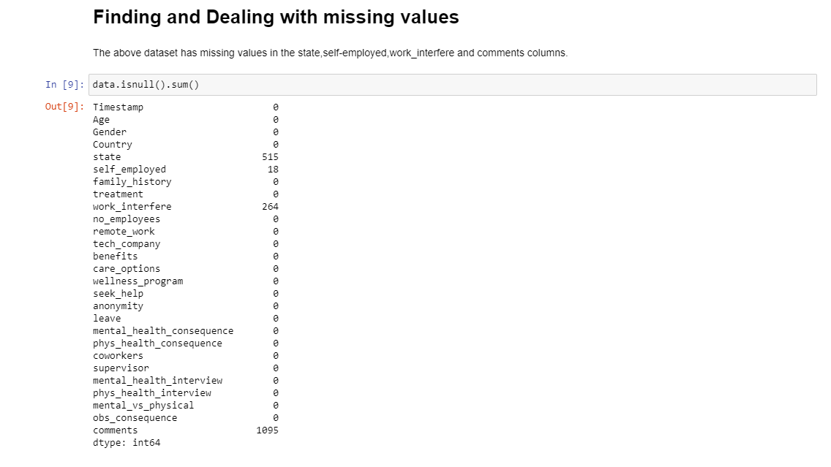

Slide 8
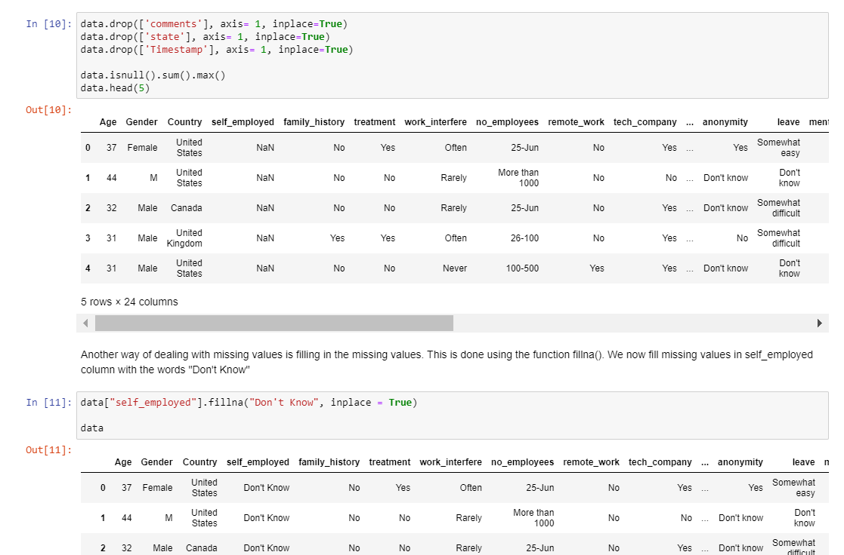

Slide 9
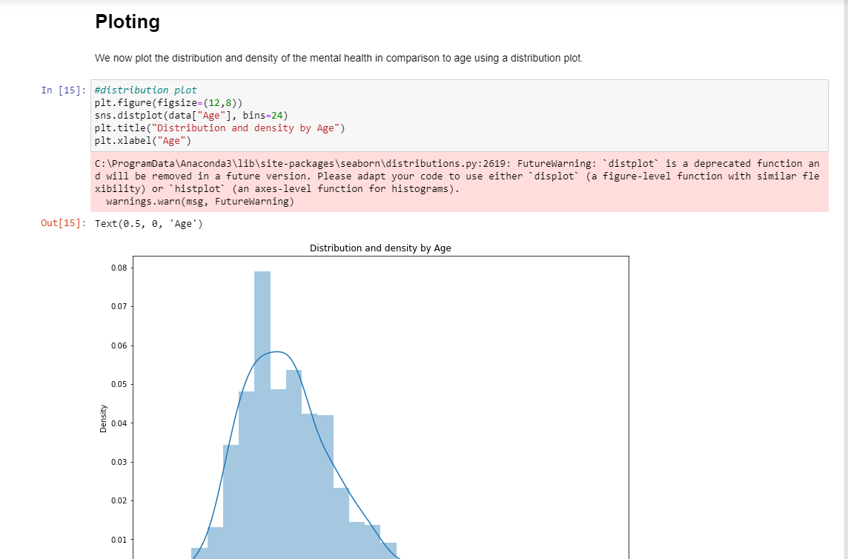

Plotting

Slide 10
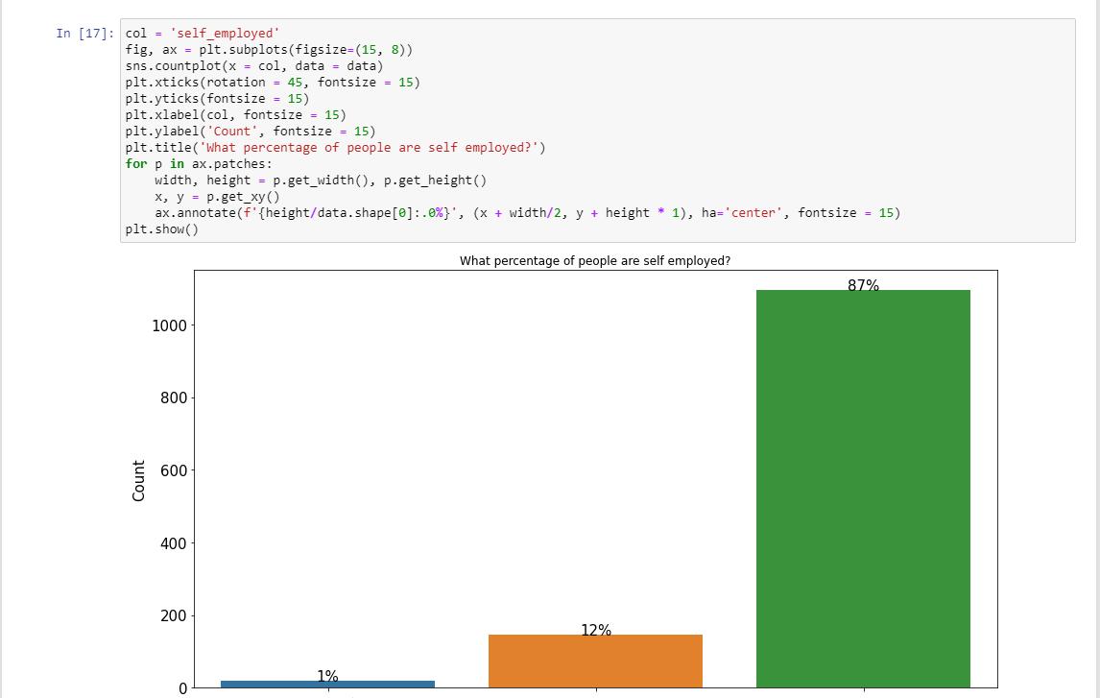

Slide 11
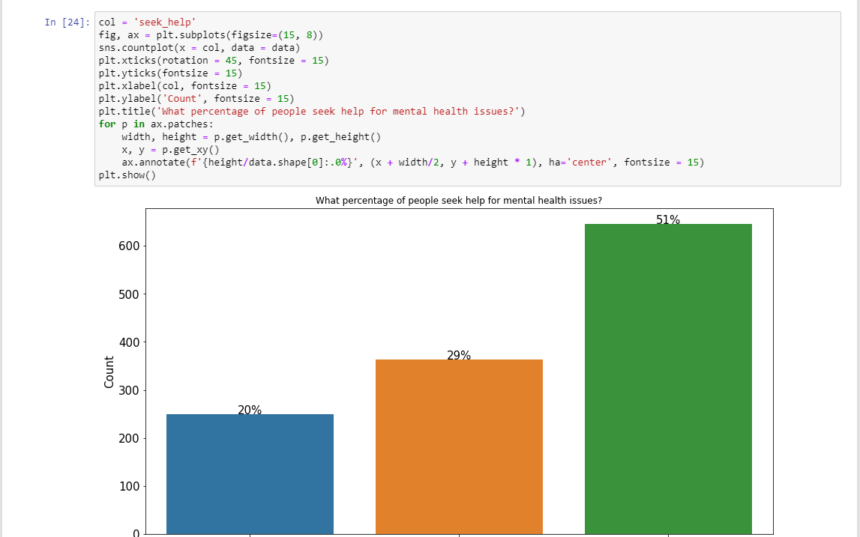

Slide 12
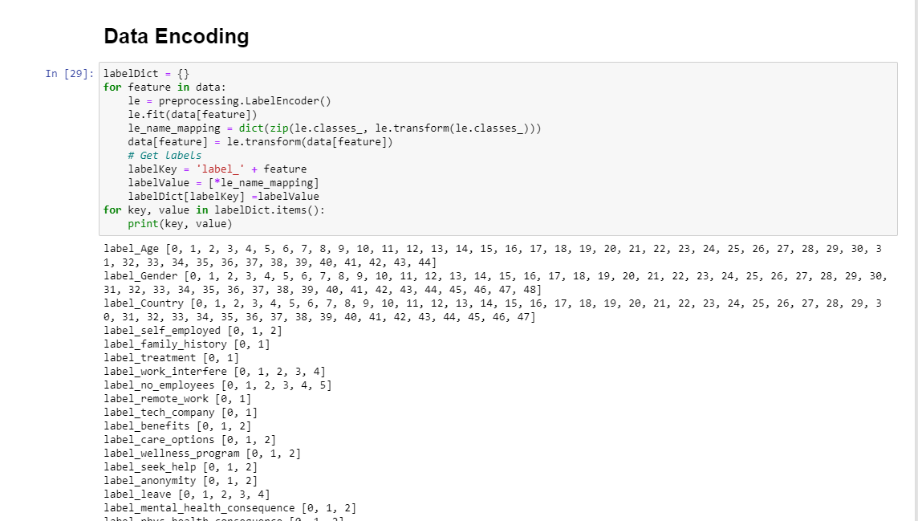

Slide 13
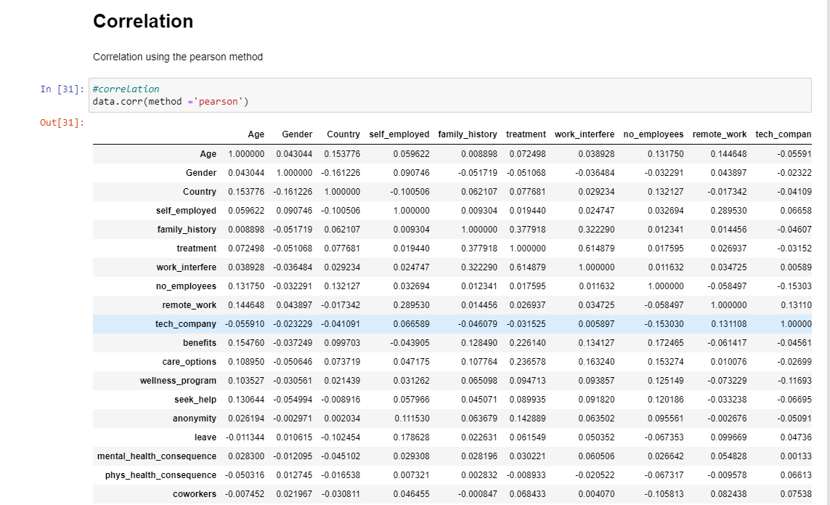

Slide 14
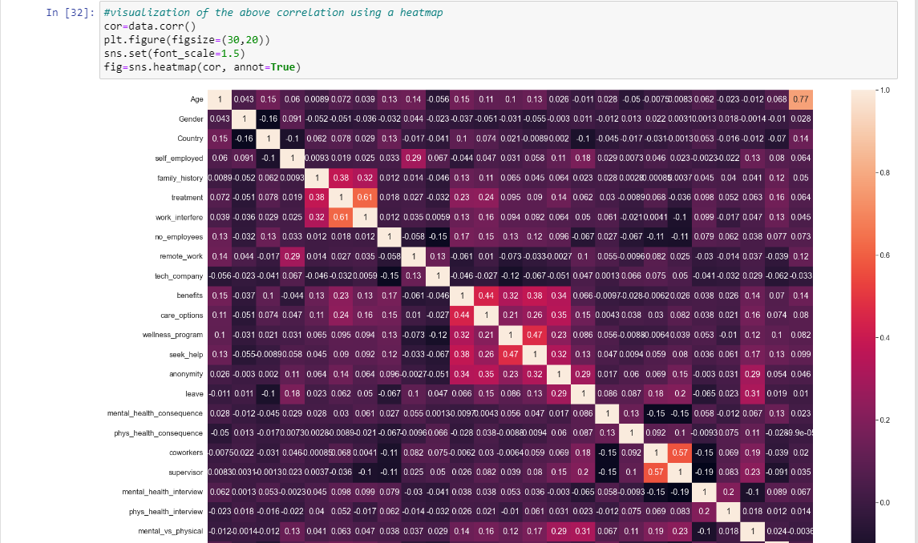

Slide 15
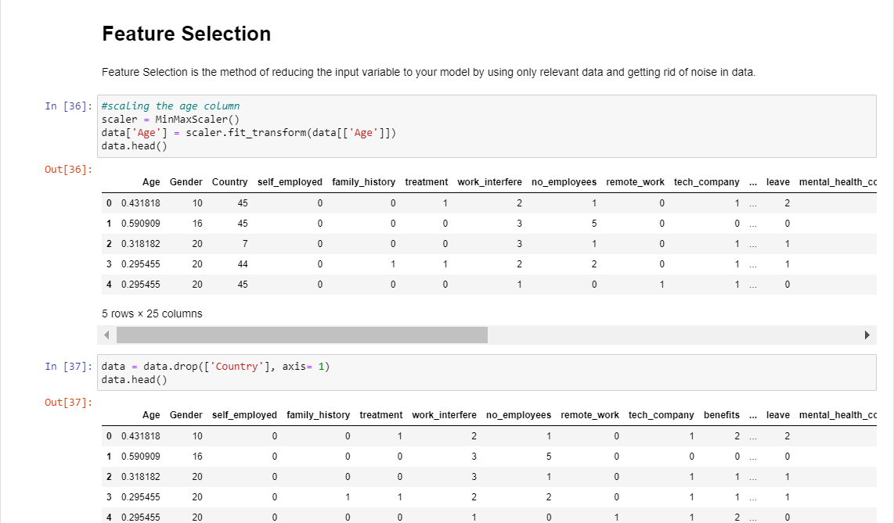

Slide 16
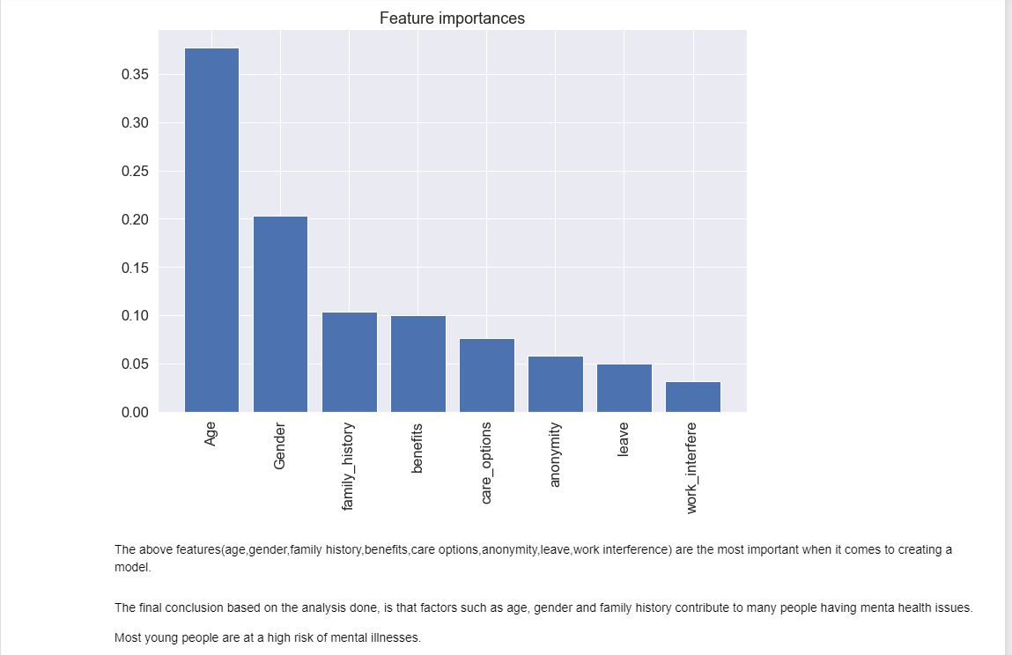

Slide 17
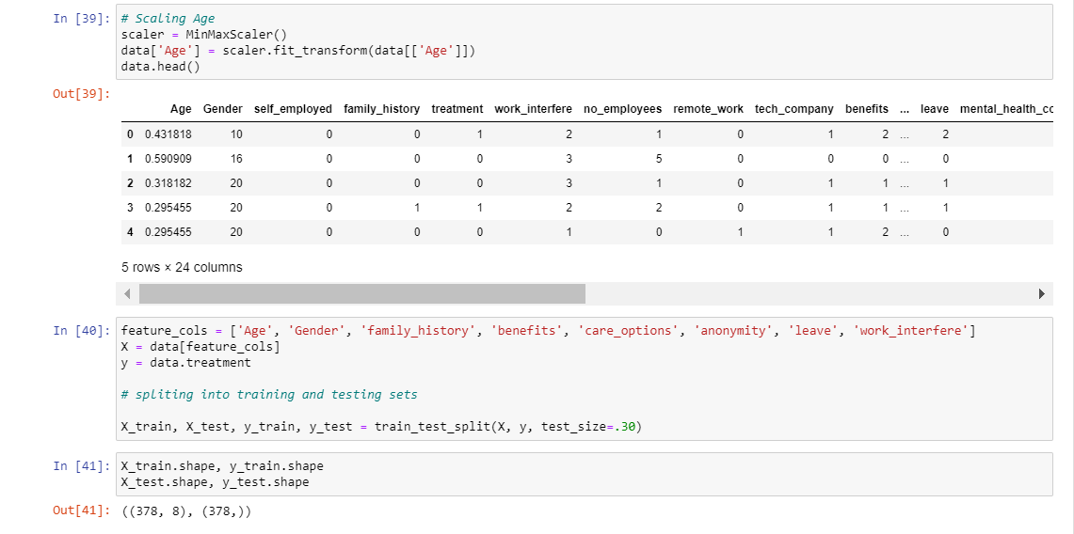

Slide 18
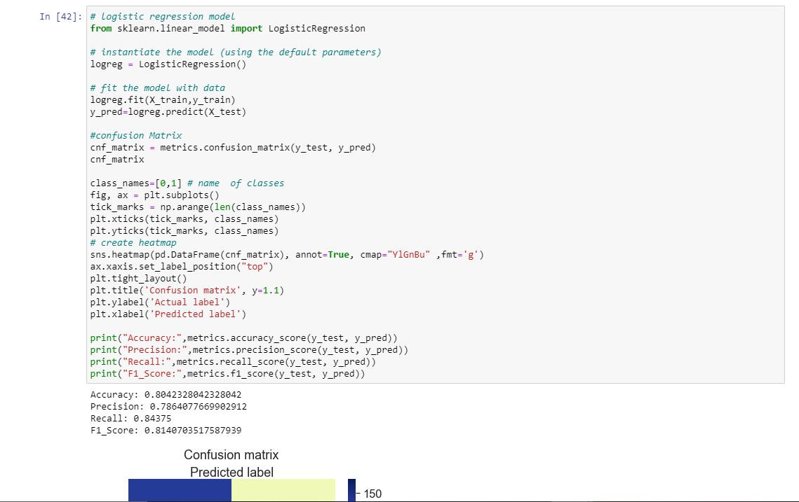

Slide 19
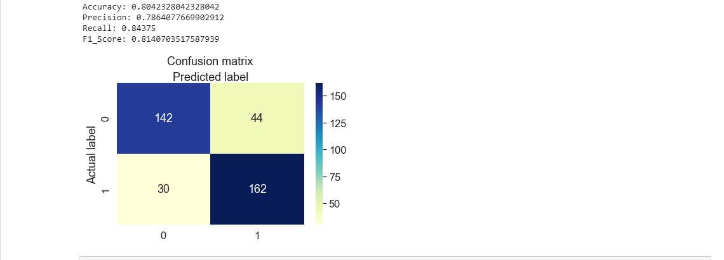

Slide 20
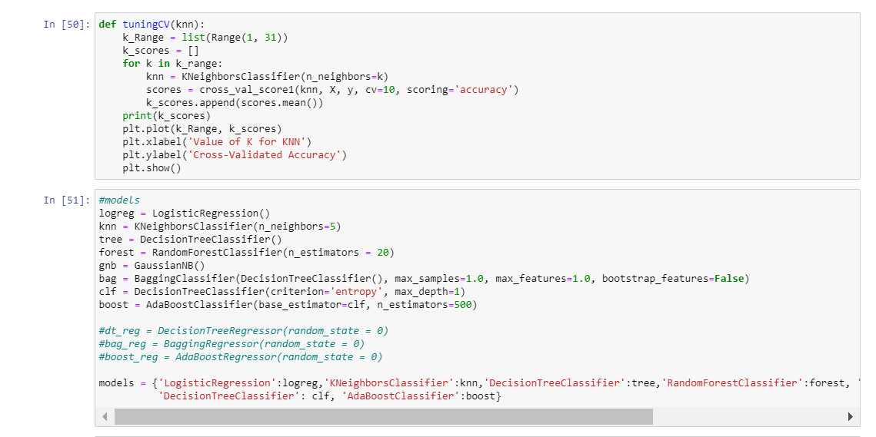

Slide 21
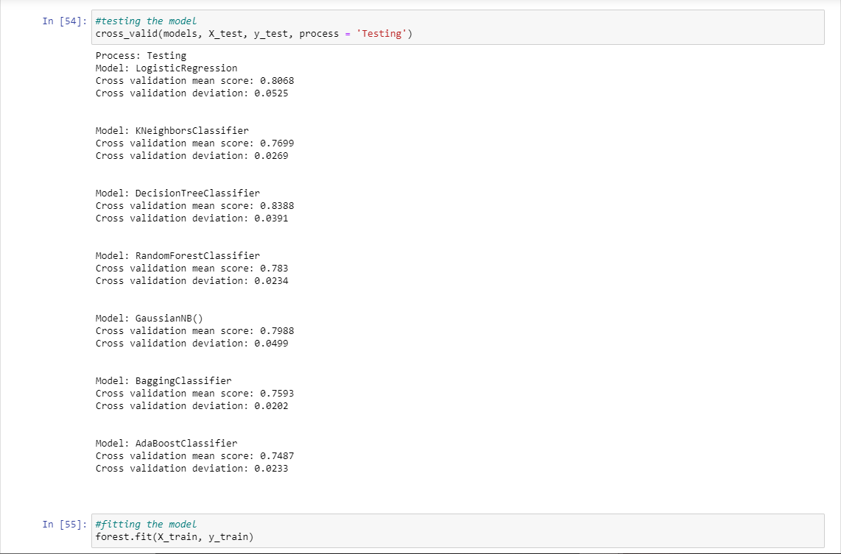

Slide 22
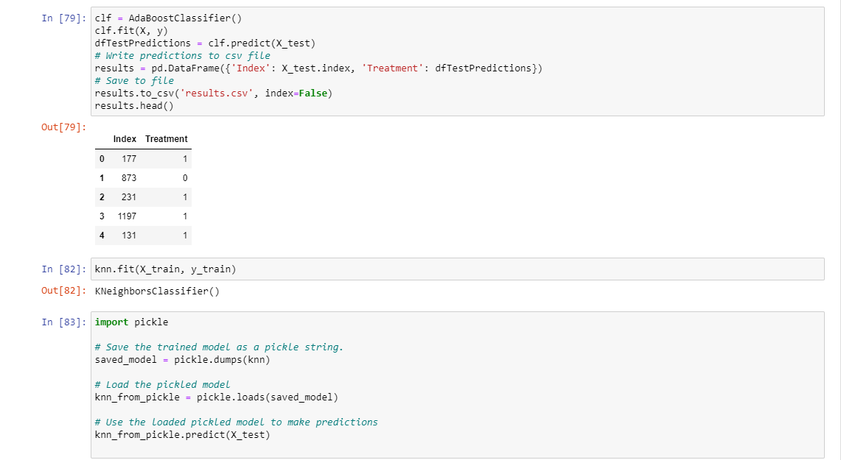

Slide 23


